Slide 1

BRAIN TUMOR DETECTION USING MACHINE LEARNING
MACHINE LEARNING FOR ROBOTICS II
Under the guidance of
Prof. Luca Oneto
Presented by,
NIRMAL KUMAR RAVIKUMAR – 5168055
Krishant tharun – 5168143
Shahrzad Eskandari Majdar - 5060737
ROBOTICS ENGINEERING

Slide 2

AGENDA
INTRODUCTION
ARCHITECTURE OF THE WORKFLOW
DATA COLLECTION
DATA PREPROCESSING
DATA SPLITTING
MODEL BUILDING
MODEL TRAINNING
ROBOT IMPLEMENTATION

Slide 3
introduction
The aim of this project is to build a model for detecting or predicting brain tumor using Convolutional neural network classifiers in tensor flow and keras & how it can be used to implement it into the field of robotics.

Slide 4
Architecture of the workflow
1. DATA COLLECTION
5. MODEL BUILDING
4. SPLITTING DATA (TRAIN, TEST, VALIDATION)
2. DATA PREPROCESSING
3. LOADING DATA AND PLOTTING SAMPLE IMAGES
6. MODEL TRAINING
7. MODEL DEPLOYMENT

Slide 5
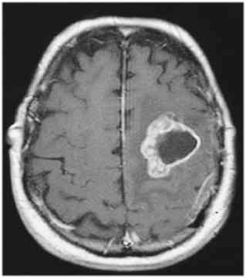
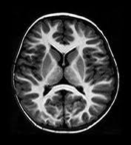
Data collection
Here the process involves the collecting of magnetic Resonance imaging (MRI) images of the patient's brain.
The collected data are such as Brains posse's tumor (after agumentation ) -1085
Brains doesn’t posse's tumor (after augumentation)- 980
Tumorous
Non -Tumorous

Slide 6

Data PREprocessing
The collected data is then preprocessed using techniques such as image resizing.
Normalization is a process that changes the range of pixel intensity values in an image.
Methods like erosions and dilations to remove any small regions of noise.
And cropping a precise image form the given data (MRI scans)

Slide 7

Data splitting
Here the data are split into three sets such as train data, validation data and testing data.
The 70% of the data are for training , 15% for validation and the other 15% testing.
Training data samples – 1445
Validation data samples - 310
Test data samples – 310
Total No of samples - 2065

Slide 8

MODEL BUILDING
The classification approach we have used is the CNN (Convolutional Neural Network).
CNNs are a type of deep learning algorithm that are particularly well-suited for image classification tasks. The basic Idea behind CNNs is to extract high-level features from images using multiple convolutional and pooling layers.

Slide 9
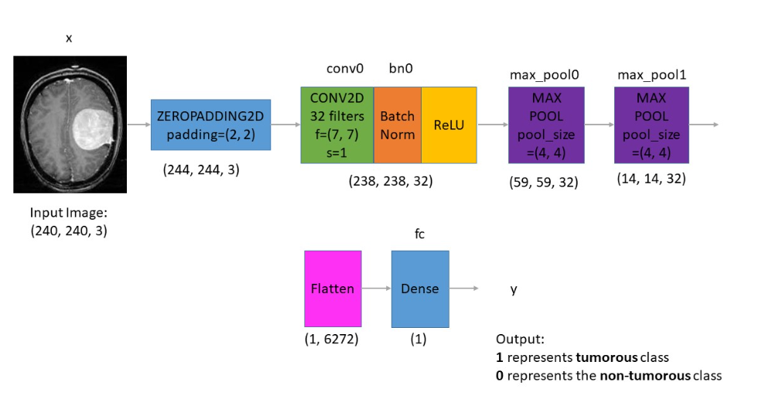
CNN architectural layers:

Slide 10
CNN architectural layers:
INPUT LAYER: The input layer receives the preprocessed brain scan images.
CONVOLUTIONAL LAYER: The convolutional layer applies a set of filters to the input image to extract features such as edges, lines, and textures. In our case 32 filters are used.
ACTIVATION LAYER: The activation layer applies a nonlinear activation function such as ReLU to the output of the convolutional layer to introduce nonlinearity into the model. The ReLU used has a activation function is used to skip the non-linear negative outputs.

Slide 11
CNN architectural layers:
4. POOLING LAYER: The pooling layer down samples the output of the activation layer to reduce the spatial dimensions of the features and introduce translation invariance into the model. Here we use the MAX POOL multiple times.
5. FULLY CONNECTED LAYER: The fully connected layer takes the output of the pooling layer and maps it to the output class labels (i.e., tumor or non-tumor) using a soft max activation function.
The CNN is trained using a backpropagation algorithm that adjusts the weights of the filters based on the difference between the predicted output and the actual output. Once trained, the CNN can be used to classify new brain scan images as either tumor or non-tumor.

Slide 12
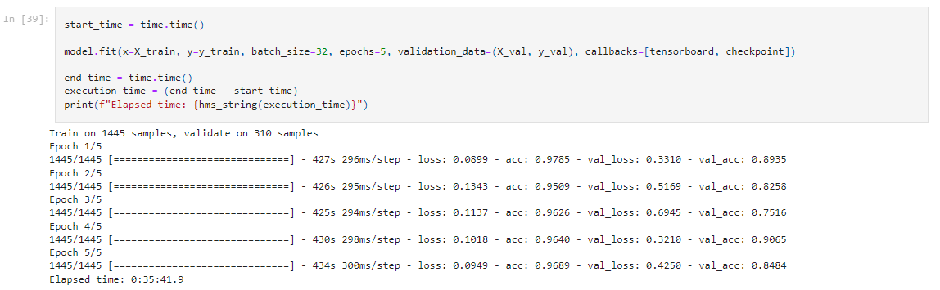
Model training
In this training phase, we acquire Train loss, train accuracy, Validation loss and validation accuracy through each epoch.
Forward and backward propagation through the entire data happens for each individual epochs.
We Train 1445 samples and validate on 310 samples
Totally 24 epochs are made repeated newly each time resulting with subsequent train loss and accuracy, validation loss and accuracy.

Slide 13
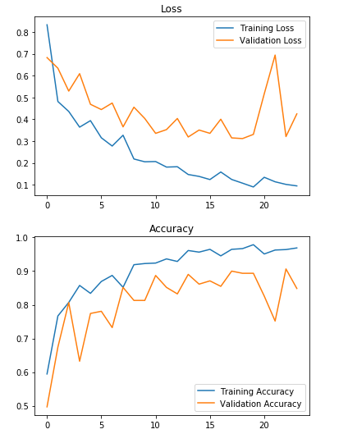
Plotting, loss and accuracy. Plotting, loss and accuracy.
The Fig 1 depicts the train and validation loss.
The Fig 2 depicts the train and validation accuracy.
From this we can conclude that the data are not overfitting thereby it has good accuracy.
After 23rd Iteration Validation accuracy – 91%
Since with this level of accuracy is achieved , lets look into how this approach can be implemented on a robot.
Fig1
Fig 2

Slide 14
ROBOT IMPLEMENTATION
HARDWARE SETUP: The first step is to set up the hardware components required for the brain tumor detection system. This includes a camera or scanner for capturing brain scan images, a computer or server for processing the images, and the Pepper robot for interaction with the user
SOFTWARE INTEGRATION: The next step is to integrate the machine learning models (CNN) with the robot's software platform. This can be done using a programming language such as Python, along with libraries such as OpenCV, Keras, and scikit-learn. The software should be able to capture brain scan images from the camera or scanner, preprocess the images, and classify them as tumor or non-tumor using the machine learning models.
USER INTERACTION: The Pepper robot can be programmed to interact with the user, guide them through the brain scan process, and provide feedback on the results of the tumor detection. The robot can display the brain scan images on its screen, ask the user to confirm the presence of a tumor, and provide information on the accuracy of the detection.
DEPLOYMENT: Once the software and hardware components are integrated, the brain tumor detection system can be deployed on the Pepper robot. The robot can be used in hospitals, clinics, or other medical facilities to assist doctors and radiologists in the diagnosis of brain tumors

Slide 15

THANK YOU
Nirmal kumar Ravikumar (5168055) – nirmalkumarr9972gmail.com
Krishant tharun (5168143) – Tharun17898@gmail.com

